Slide 1
CSCIU 210 Computer Organization AKM Jahangir A Majumder, PhD
Fall 2018 - Lecture 27
November 2, 2018
Note: Some slides are adapted from those used by previous instructors and some slides include figures from the textbook.

Slide 2
Review and Learning Outcomes
We will CONTINUE our coverage on MIPS assembly language
We will learn followings today:
Memory vs. Register
MIPS Register Conventions
MIPS Control Instruction
We will learn how to write code in MIPS simulator
We will have Quiz 5 today, which will cover lecture 20-24
Key for HW 5 is posted on Blackboard
We will have Exam 2 on Friday, Nov 16 and Quiz 6 will be on Wednesday, Nov 14

Slide 3
Example Program 5
Write a program implementing the following functions.
Ask the user to enter a number with the following prompt
"enter name, followed by comma-enter:”
Type your name followed by comma
Print out the result after the following message
“Dear Your name, Your HW is overdue. Please turn your HW ASAP. Thank you!"

Slide 4
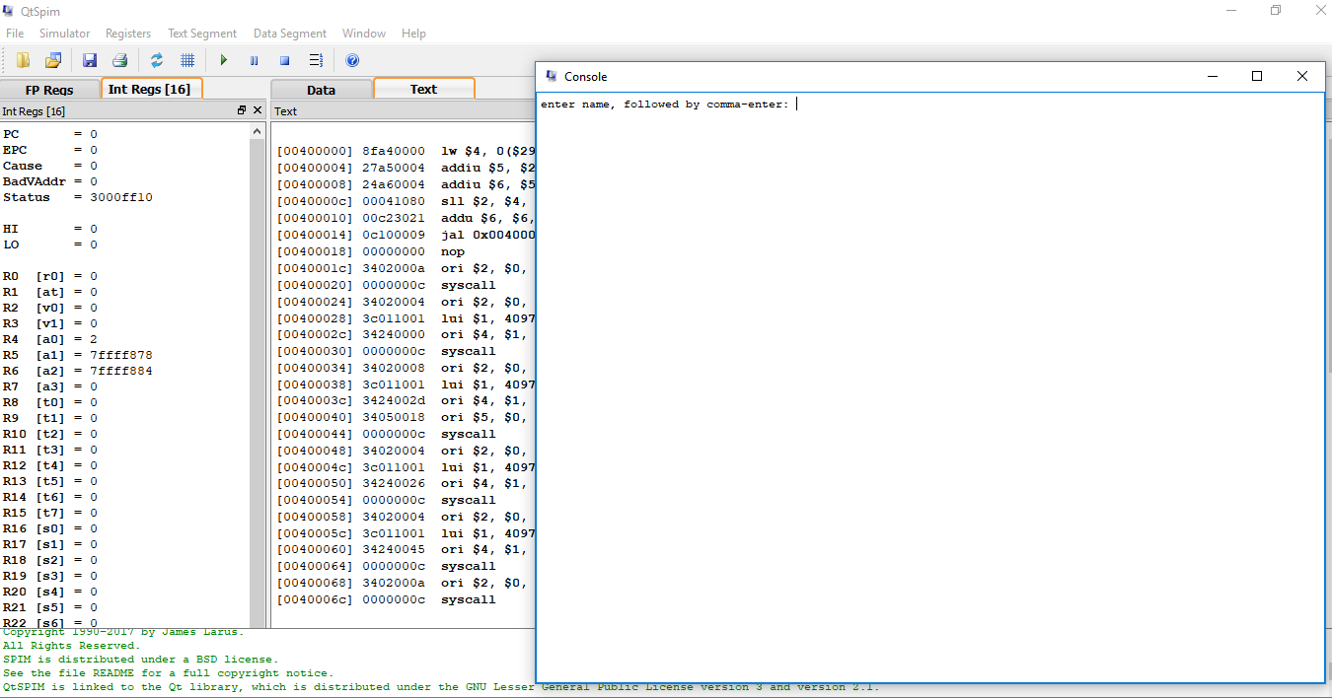
Result of Example Program 5

Slide 5
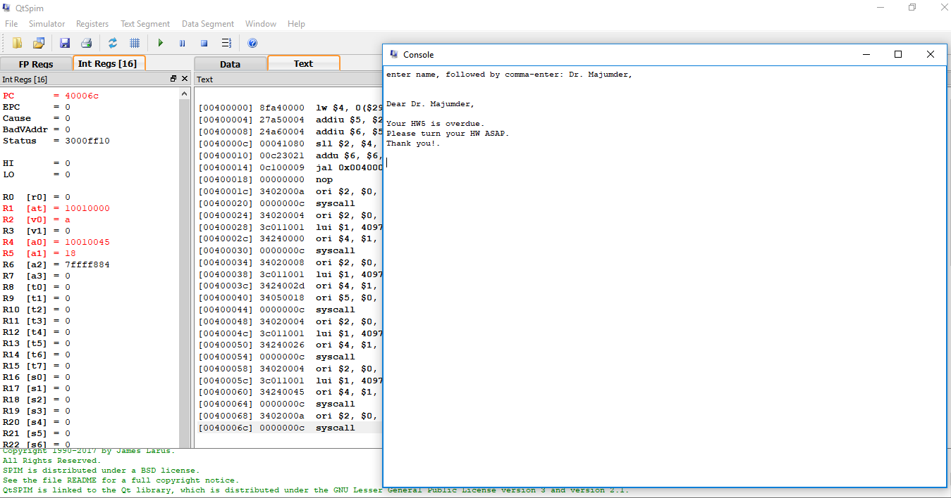
Result of Example Program 5

Slide 6
The Fifth Program: HW Overdue
# overdue.asm
.text
.globl main
main:
# get patron name
li $v0,4 # print prompt
la $a0,prompt #
syscall
li $v0,8 # code 8 == read string
la $a0,name # $a0 == address of buffer
li $a1,24 # $a1 == buffer length
syscall # Invoke the operating system.
# print the letter
li $v0,4 # print greeting
la $a0, letter #
syscall
li $v0,4 # print body
la $a0,body #
syscall
li $v0,10 # exit
syscall
.data
prompt: .asciiz "enter name, followed by comma-enter: "
letter: .ascii "\n\nDear "
name: .space 24
body: .ascii "\nYour HW5 is overdue.\n"
.ascii "Please return your HW ASAP.\n"
.asciiz "Thank you!.\n\n"

Slide 7
Review: MIPS Data Transfer Instructions
We learned the following two MIPS data transfer instructions:
Load word
lw $s1, 100($s2) $s1 = Memory[$s2+100]
Save word sw $s1, 100($s2) Memory[$s2+100] = $s1

Slide 8
MIPS Data Transfer Instructions Example
Word Address
C code: A[12] = h + A[8]; MIPS code: lw $t0, 32($s3) # load word add $t0, $s2, $t0 sw $t0, 48($s3) # store word
$s3: base address (as called index register)
Can refer to registers by name (e.g., $s2, $t2) instead of number
Store word has destination last
Remember arithmetic operands are registers, not memory! Can’t write: add 48($s3), $s2, 32($s3)
Byte Address

Slide 9
Exercise: Data Transfer Instructions
C code: A[100] = h + A[100]; MIPS code: ?
$t0: temporary register to store A[100]
$t1: index register
$s2 corresponds to h

Slide 10
Machine Language Type of Load/Store Instructions
Example: lw $t0, 32($s2) 35 18 8 32 op rs rt 16 bit number
Example: sw $t0, 32($s2) 43 18 8 32 op rs rt 16 bit number

Slide 11
Pointers v. Values
Key Concept: A register can hold any 32-bit value. That value can be a (signed) int, an unsigned int, a pointer (memory address), and so on
If you write add $t2,$t1,$t0 then $t0 and $t1 better contain values
If you write lw $t2,0($t0) then $t0 better contain a pointer
Don’t mix these up!

Slide 12
Addressing: Byte vs. Word
Every word in memory has an address, similar to an index in an array
Early computers numbered words like C numbers elements of an array:
Memory[0], Memory[1], Memory[2], …
Called the “address” of a word
Computers needed to access 8-bit bytes as well as words (4 bytes/word)
Today machines address memory as bytes, (i.e.,“Byte Addressed”) hence 32-bit (4 byte) word addresses differ by 4
Memory[0], Memory[4], Memory[8], …

Slide 13
Compilation with Memory
What offset in lw to select A[5] in C?
4x5=20 to select A[5]: byte v. word
Compile by hand using registers: g = h + A[5];
g: $s1, h: $s2, $s3:base address of A
1st transfer from memory to register:
lw $t0,20($s3) # $t0 gets A[5]
Add 20 to $s3 to select A[5], put into $t0
Next add it to h and place in g add $s1,$s2,$t0 # $s1 = h+A[5]

Slide 14
Notes about Memory
Pitfall: Forgetting that sequential word addresses in machines with byte addressing do not differ by 1.
Many an assembly language programmer has toiled over errors made by assuming that the address of the next word can be found by incrementing the address in a register by 1 instead of by the word size in bytes.
So remember that for both lw and sw, the sum of the base address and the offset must be a multiple of 4 (to be word aligned)

Slide 15
More Notes about Memory: Alignment
MIPS requires that all words start at byte addresses that are multiples of 4 bytes
Last hex digit of address is:
0 1 2 3
Aligned
0, 4, 8, or C_{hex}
1, 5, 9, or D_{hex}
Not
Aligned
2, 6, A, or E_{hex}
3, 7, B, or F_{hex}
Called Alignment: objects must fall on address that is multiple of their size.

